Slide 1
Virtual tour leader

Slide 2
The pdm

Slide 4
Laravel-phpstorm

Slide 5
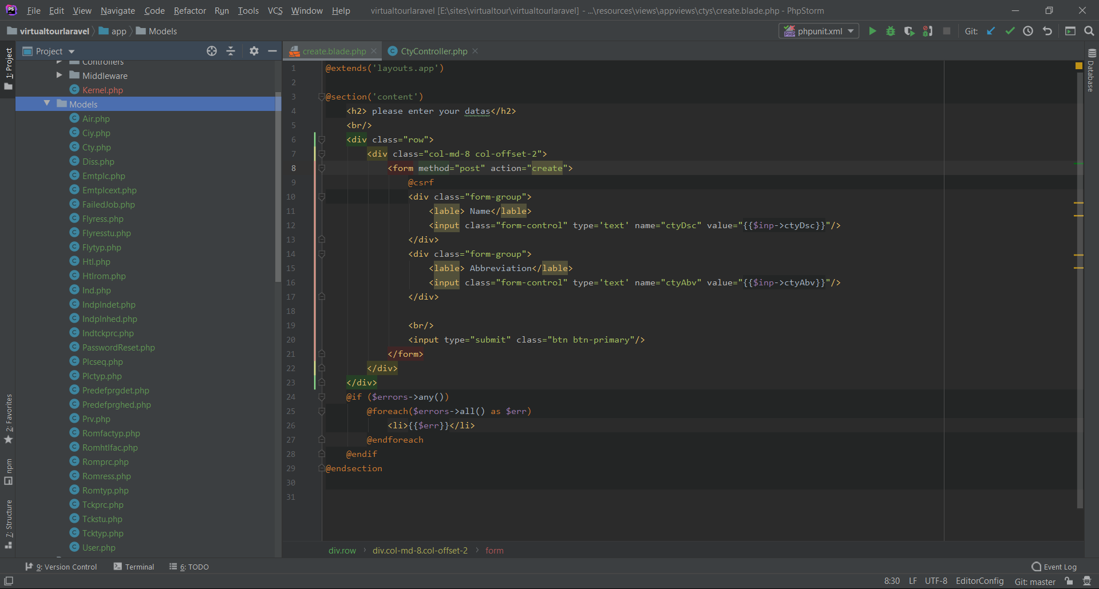

Slide 6
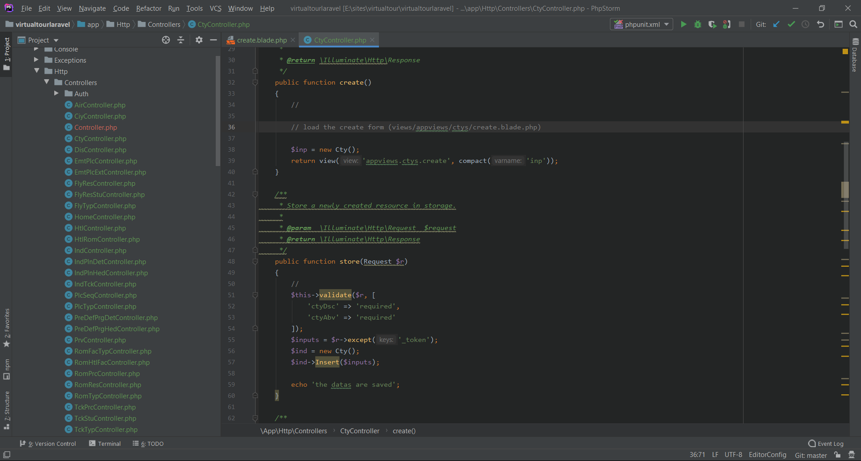

Slide 7
